Slide 1
“SIMPLIFY YOUR SHOPPING”
A Product Recommendation System
Group -28
Tarun k Gupta, Kartik Gupta, Ritika Nagar, Shubham Sethi , Rachit Gupta, Akshat Tilak

Slide 2

What problems do people face??
Recommendation redundancy
Unpredictability concerning new items (cold start)

Slide 3


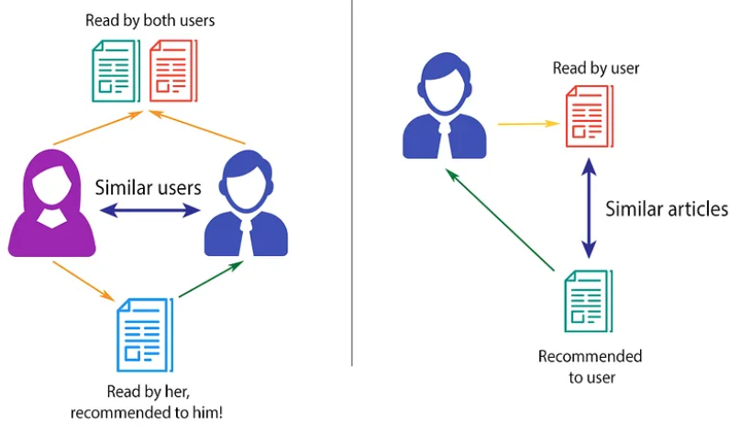
Proposed System
Our product recommendation system aims to provide users with more choices in the ways that products are recommended to them by providing multiple models for users to choose from which can help predict their preferred products depending on their needs. We are providing users with models based on content, collaborative filtering and popularity.
To address the cold start problem, we have incorporated a popularity filtering mechanism that recommends popular items to new users.
For existing users, we have merged content-based and collaborative filtering approaches based on their likes and dislikes, as well as those of similar users.

Slide 4

Let’s shop smarter now
Several Research studies have explored the use of product recommendation system to assist people.

Slide 5
Literature Survey:
This paper discussed the era of the web, in which a lot of information is overloaded over the Internet. Recommender system algorithms are widely used in e-commerce to provide personalized and more accurate recommendations to online users and enhance the sales and user stickiness of e-commerce.
The report highlights the discussion of the types of the recommender systems as general and types of CF such as; memory based, model based, and hybrid model. In addition, this report discusses how to choose an appropriate type of CF
The paper highlights how the Popularity based recommendation system works with the current vogue. It explains how it basically uses the items which are in swing at present.
“Study of an E-commerce recommender system: Oxbridge college, kunning university”
“Collaborative Filtering for Recommender Systems Publication: 2014 Second International Conference on Advanced Cloud and Big Data ”
“Popularity-Based Recommendation System: International Journal of Engineering and Advanced Technology (IJEAT)”

Slide 6

NOVELTY
Our product recommendation system have used a novel approach that incorporates a hybrid different filtering mechanisms. It provides:
Comprehensive
Accurate recommendation
It takes into account the unique preferences and needs of each user. By offering personalized and relevant recommendations, we can enhance the user's shopping experience, increase customer satisfaction.

Slide 7
Proposed Methods
Popularity Based Recommendation System
In this product model, we recommend products to the user according to the highest mean average rating of products. In this, we only consider the rating of those users who have rated at least 5(a threshold that can change) different products.
Content Based Recommendation System
In this product model , we recommend products to the user based on Cosine similarity or a euclidean distance of the vector of two products(item).
Collaborative- Based Recommendation System
In this product model, we have used Singular value decomposition (SVD) for the user’s product prediction and have used MSE (Mean Squared Error) in the evaluation matrix.

Slide 8
Working
3. We have converted our data into a pivot table where the rows represent user IDs and the columns represent Product Names.
5. we were able to generate personalized product recommendations for each user based on their past product ratings and the preferences of similar users
Firstly,we extract the a real world and practical dataset for our model and store them as a CSV file.
4. We have then used cosine similarity to find similar users based on their likes and dislikes of the products, and identified the most similar users.
2. Then, we will be doing preprocessing of data by doing systematic examination of a dataset using EDA and transform the raw data to a format suitable.

Slide 9
Thank you.

